Slide 1


PAAVAI ENGINEERING COLLEGE (AUTONOMOUS) DEPARTMENT OF INFORMATION TECHNOLOGY PREDICTION AND ANALYSATION OF ROAD
SAFETY MANAGEMENT SYSTEM MAIN REVIEW BATCH NO: 5
GUIDED BY: PRESENTED BY:
DR.B.VENKATESAN, KAMATCHI PRIYA D(20202025)
B.E.,M.E.,Ph.D. , BALESHWARAN D(20202005)
HEAD OF THE DEPARTMENT,
INFORMATION TECHNOLOGY,
PAAVAI ENGINEERING COLLEGE.

Slide 2
OBJECTIVE OF THE PROJECT
Road accidents pose significant threats to public safety, often requiring prompt emergency response.
Utilizing CCTV footage, this project aims to develop a deep learning-based system for real-time analysis and identification of objects involved in accidents.
The system will employ advanced object detection algorithms to recognize vehicles, pedestrians, and other relevant entities.
Additionally, it will integrate a greedy search algorithm to determine the optimal and shortest routes to nearby emergency facilities, including hospitals, police stations, and fire stations.

Slide 3
ABSRACT
Road accidents continue to be a pressing concern for public safety worldwide. In this project, we propose a comprehensive solution leveraging image recognition and deep learning techniques to enhance emergency response efficiency following road accidents.
By harnessing CCTV footage, our system employs advanced computer vision algorithms to accurately analyze and identify objects involved in accidents, including vehicles, pedestrians, and other relevant entities
The key innovation lies in training conventional algorithms within a deep learning framework to achieve superior object detection capabilities.

Slide 4
ABSRACT CONTENT
This approach enables the system to adapt and learn from diverse real-world scenarios, resulting in robust performance in identifying accident-related objects. Furthermore, to optimize emergency response, we integrate a greedy search algorithm to determine the shortest and most efficient routes to nearby emergency facilities, such as hospitals
This ensures swift and effective assistance to accident victims, potentially reducing response times and minimizing casualties.

Slide 5
ABSRACT CONTENT
Real-world deployment scenarios are considered to assess the practical applicability and effectiveness of the proposed solution.Overall, our project aims to significantly improve the response capabilities to road accidents, ultimately contributing to enhanced public safety and reduced loss of life and property.
Keywords:Accidents, Automobiles, Feature extraction, Deep learning, Cameras, Real-time systems, Roads, Car accident detection, CVIS, machine vision, Computer Vision

Slide 6
EXISTING SYSTEM-ADAPTIVE METHOD
The Adaptive Method in the existing system employs real-time feedback mechanisms to adjust system parameters dynamically, ensuring optimal performance under varying conditions.
It utilizes deep learning algorithms to analyze data and make adaptive decisions, enhancing system efficiency and responsiveness to changes.
This method facilitates continuous improvement and adaptation, leading to more robust and effective system operation.

Slide 7
EXISTING SYSTEM-HARDWARE
The existing system hardware comprises high-performance servers equipped with multi-core processors and ample RAM, along with redundant network infrastructure to ensure reliability and scalability.
Additionally, it includes robust storage solutions such as RAID arrays or SSDs for efficient data storage and retrieval.

Slide 8
EXISTING SYSTEM- MINUTIAE
The existing system minutiae include detailed configurations of hardware components, software versions, network topology, security protocols, and data processing algorithms utilized within the system architecture.
Additionally, it encompasses operational procedures, maintenance schedules, and performance metrics for monitoring and optimizing system functionality.

Slide 9
EXISTING SYSTEM- NORMALIZATION
In the existing system, normalization techniques are applied to preprocess data, ensuring uniformity and consistency across different data sources and formats.
These techniques help mitigate biases and improve the efficiency and accuracy of subsequent analysis and decision-making processes.

Slide 10
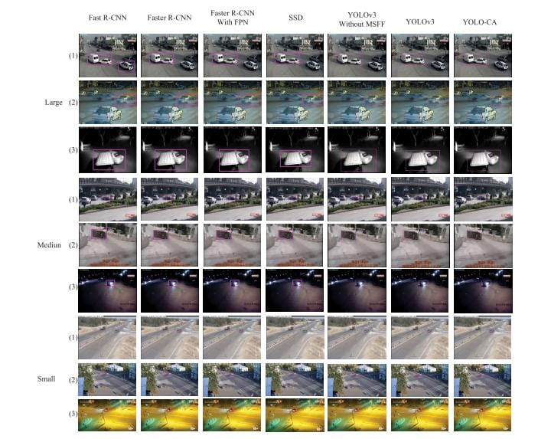
PROPOSED SYSTEM:
The System detects the accidents from the footage of the CCTV and give the alert message / alarm that the accident is happened with the image/video proof.
This system automatically give the alert to the Hospitals and the Police Stations, In case the fire is detected from the accident this system give the alert to the fire stations.

Slide 11
BLOCK DIAGRAM-PROPOSED SYSTEM
Input – accident video file
Choose accident video to deduct
Start deduction
Accident deducted
Output- sent an alert message

Slide 12
SYSTEM DESIGN-DISTORTION DETECTION
YOLO ALGORITM
Feature extraction
Data preprocessing
Feature vector
Input accident video
Accident probability
accident
or
no accident
Image recognition

Slide 13
SYSTEM DESIGN-DISTORTION RECTIFICATION
Distorted accident video
Feature
Preprocessing module
Image recognition
Extraction
Feature vector
Distortion field
Inverse process of accident deduction
Analyze the uploaded accident video
Rectified accident deduction

Slide 14
ALGORITHM
1. YOLO is known for its speed, making it suitable for real-time applications like self-driving cars or video surveillance.
2. It achieves this by performing a single forward pass through the convolutional neural network (CNN) to predict bounding boxes and class probabilities for objects in an image.
3. Unlike some object detection algorithms that involve separate stages for proposal generation and classification, YOLO performs both tasks in a single stage.

Slide 15
ALGORITHM CONTENTS
4. YOLO predicts bounding boxes around detected objects in an image. These boxes indicate the location and size of the objects.
5. Along with bounding boxes, YOLO assigns a probability score to each box, indicating the likelihood that it contains a specific object class (e.g., car, person, bicycle).
6. YOLO divides the image into a grid of cells. Each cell predicts bounding boxes and class probabilities for objects that appear within its boundaries.

Slide 16
ALGORITHM CONTENTS
7. YOLO predicts multiple bounding boxes (often referred to as anchor boxes) with different sizes and aspect ratios. This helps the model detect objects of varying shapes and sizes.
8. When multiple bounding boxes overlap significantly for the same object, YOLO employs a technique called Non-Max Suppression (NMS). NMS helps eliminate redundant detections and keeps the most confident prediction for each object.

Slide 17
ALGORITHM CONTENTS
9. While YOLO offers speed advantages, it may not always achieve the highest accuracy compared to some two-stage object detection algorithms. However, newer YOLO versions like YOLOv7 are continuously improving accuracy while maintaining speed.
10. YOLO's speed and real-time capabilities make it suitable for various applications, including:
Self-driving car obstacle detection
Video surveillance and anomaly detection
Traffic monitoring and analysis
Person detection and tracking
Robot vision

Slide 18
IMPLEMENTATION & MODULES
Module 1: Get CCTV footage of accidents and label objects and emergency locations.
Module 2: Create a deep learning model to spot objects.
Module 3: Integrate a route-finding algorithm for emergency facilities.
Module 4: Develop a system to analyze footage instantly.
Module 5: Try it out, fix any issues, and put it into action.

Slide 19
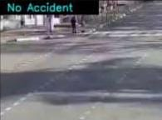
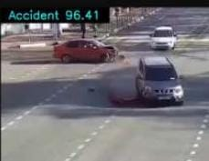
EXAMPLE INPUT AND OUTPUT
Distorted input accident image
Rectified output accident image

Slide 20
THANK YOU

